Slide 1
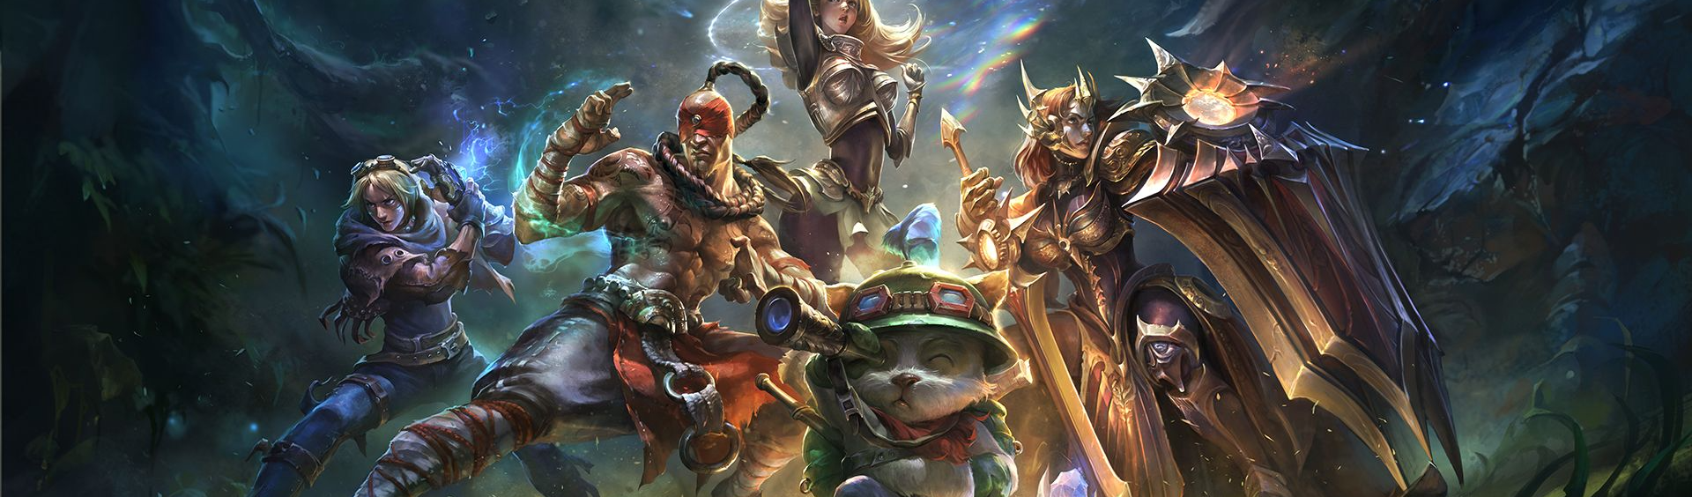
LEAGUE OF LEGENDS: WINNING TEAM ANALYSIS & GAME PREDICTION
BY ARIYAN NOOSHAZAR
Notes:
Hi my name is Ariyan Nooshazar, I am a former energy broker and now a passionate Data Scientist.

Slide 2
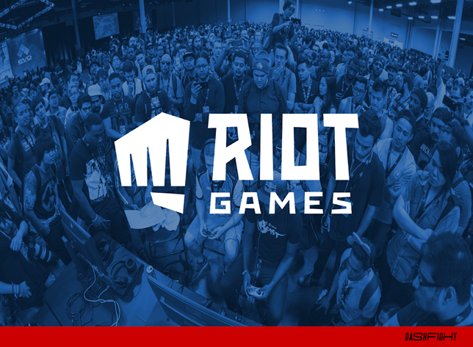
INTRODUCTION: LEAGUE OF LEGENDS
League of Legends (“LoL”) is a 5v5 multiplayer online game of two teams identified as Red and Blue, each with five unique champions and a main goal: to destroy the other team’s base, called Nexus, which is not an easy task.
Key Factors:
GOLD
EXPERIENCE (XP)
CHAMPIONS
SECONDARY OBJECTIVES
Notes:
Multiplayer online games have increased in both popularity and revenue over the last few years.
Revenue for year 2022 is projected to be US$23.56bn,
In this field we have Riot Games who created League of Legends in 2009, which is main focus of our project
DEFINE LOL
It is important to mention that League of Legends had by itself made 9 million dollars revenue last month of November

Slide 3

BUSINESS QUESTIONS
Can we predict the result of a LoL match within its first 15 minutes based on the amount of gold and XP earned by each team?
How likely are the secondary objectives able to change the game result?
Notes:
After defining our key factors, we have narrowed down two primary questions:

Slide 4
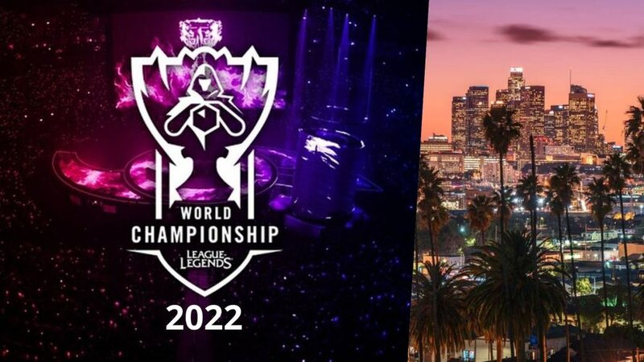
VALUE ADDED
Supports developers in improving LoL’s quality and the players’ experience
Contributes to the revenue growth of LoL as an online multiplayer game
Assists teams and organizations of professional LoL players performing in internationally renowned competitions
Notes:
Value added of our project are ;

Slide 5

MODELS
For this project, we used three models:
1. Logistic Regression
2. Decision Tree
3. XGBoost
The data was downloaded from oracleelixir.com.
Notes:
Data was collected from OE its from 2020 to 2022, 55000 games

Slide 6

SUMMARY OF OUR MODELS
GOLD AND XP EARNED |  | SECONDARY OBJECTIVES
LOGISTIC REGRESSION | 70% | LOGISTIC REGRESSION | 86%
DECISION TREE | 69% | DECISION TREE | 87%
XG BOOST | 69% | XG BOOST | 87%
Notes:
All 3 models performed well for both
Where they stand out was
GOLD AND XP
2,874( ~70.92 %) games were correctly classified for games won
* 2,803(~69.15%) games were correctly classified for matches lost
OBJECTIVE
* 3,453( ~85.21 %) games were correctly classified for games won,
* 3,628(~89.51%) games were correctly classified for matches lost

Slide 7
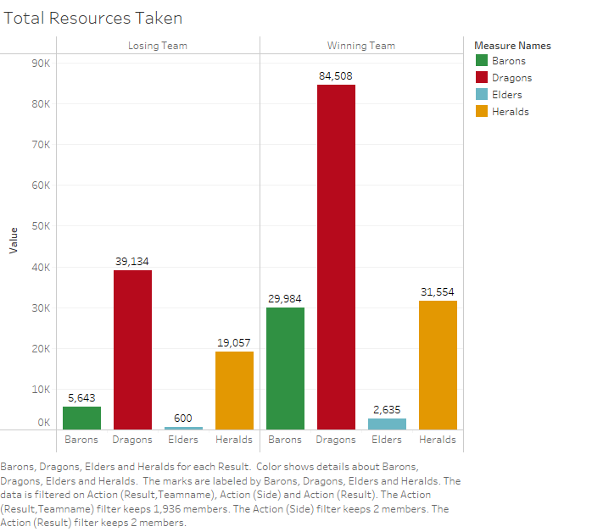
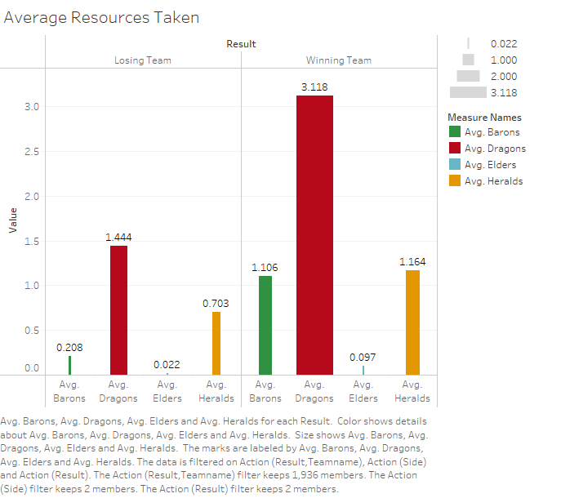
VISUALIZATIONS
Notes:
with respect to secondary objectives, we concluded the following
And iddfrence secondary objecti make on the result of the game specially dragons

Slide 8
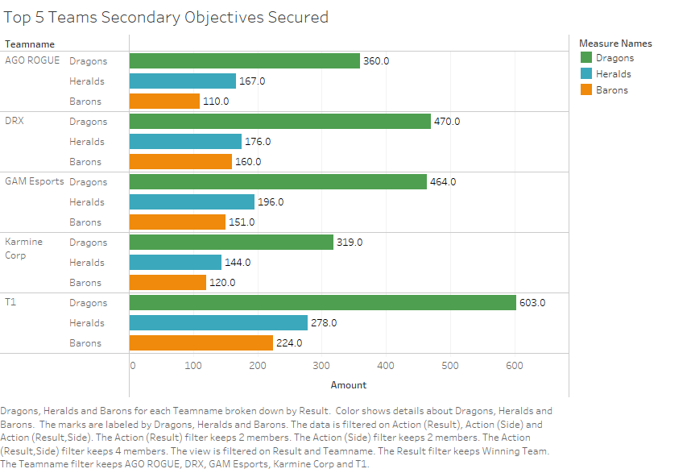
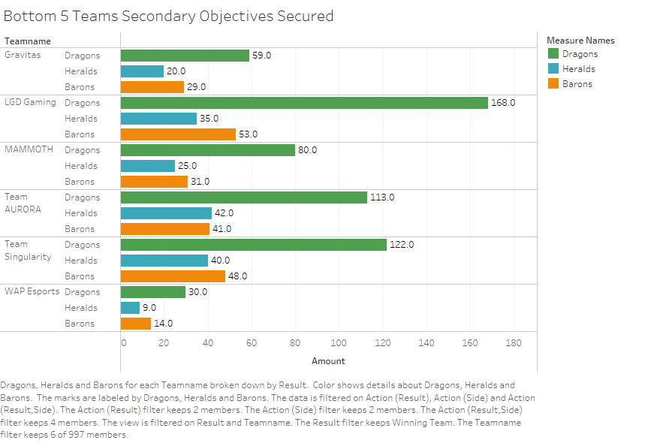
VISUALIZATIONS
Notes:
Here we can see the top 5 teams in comparison with bottom 5 teams in relation to sec OBJ.
- As we can appreciate for both losing and winning importance of the dragons slained

Slide 9
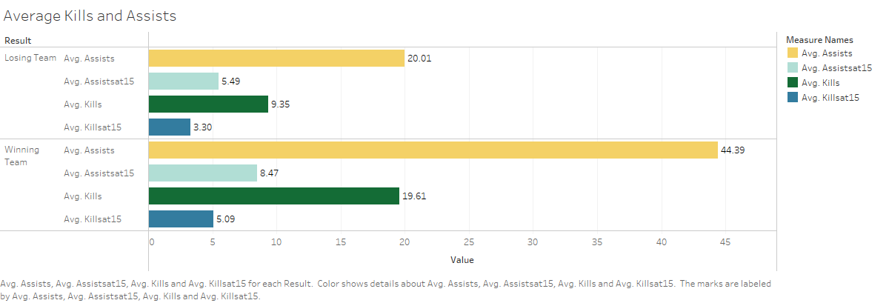
VISUALIZATIONS
Notes:
Importance of assists

Slide 10

CONCLUSION & Key Takeaways
The blue side is more prompt to win than the red side and has a higher win percentage
Importance of dragons and the correlation they have towards winning
Importance of assists and the amount of gold they can bring to the teammates.

Slide 11

THANK YOU Questions? https://www.linkedin.com/in/ariyannooshazar/ Ariyan.Nooshazar@gmail.com https://github.com/Arita09

